Slide 1


AWS Containers & Kubernetes
Udayakumar Mathivanan
Cloud Solution Architect

Slide 2
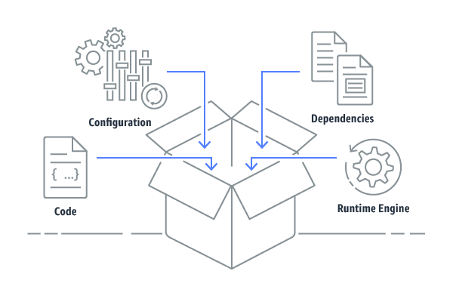
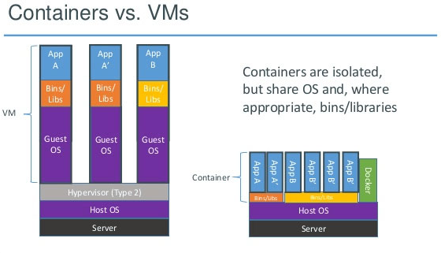
Containers
Containers provide a standard way to package your application's code, configurations, and dependencies into a single object.
Containers share an operating system installed on the server and run as resource-isolated processes, ensuring quick, reliable, and consistent deployments, regardless of environment.

Slide 3
Containers
Run Anywhere
Improve Resource Utilization
Scale Quickly

Slide 4
Containers
Build Container Image
Automate Testing
Run Anywhere
Scale Rapidly

Slide 5
Containers
Common Use Cases
Microservices
Batch Processing
Machine Learning
Hybrid Application
Application Migration to Cloud
Platform as a Service

Slide 6
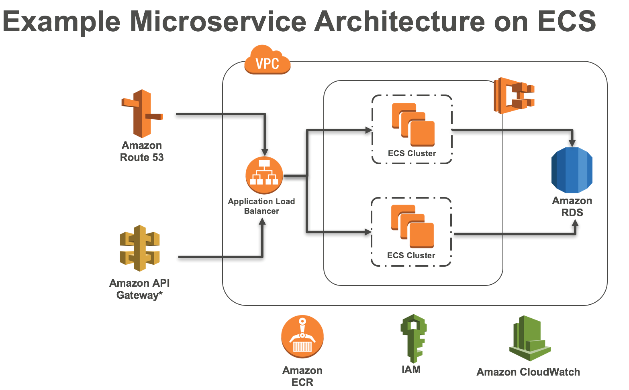
ECS
Amazon Elastic Container Service (Amazon ECS) is the Amazon Web Service you use to run Docker applications on a scalable cluster.
AWS Fargate is a compute engine for Amazon ECS that allows you to run containers without having to manage servers or clusters. With AWS Fargate, you no longer have to provision, configure, and scale clusters of virtual machines to run containers.

Slide 7
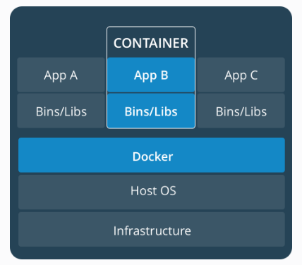
Docker
Docker is a tool designed to make it easier to create, deploy, and run applications by using containers. Containers allow a developer to package up an application with all of the parts it needs, such as libraries and other dependencies, and ship it all out as one package

Slide 8
Demo on ECS

Slide 9
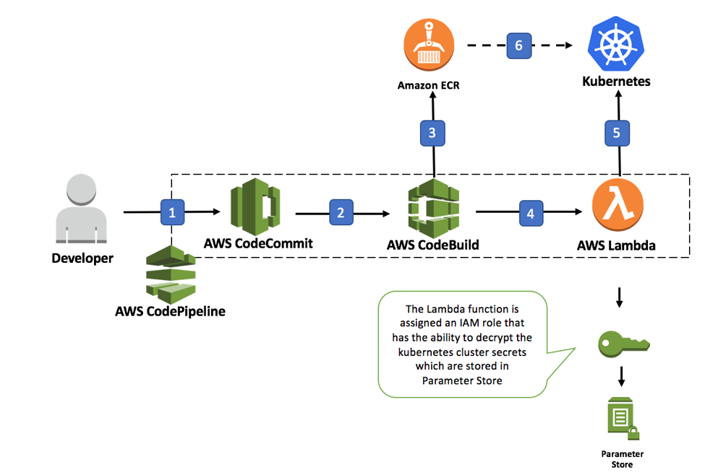
Kubernetes
Kubernetes is an open source container orchestration platform, allowing large numbers of containers to work together in harmony, reducing operational burden. Ithelps with things like: Running containers across many different machines. Scaling up or down by adding or removing containers when demand changes.
Kubernetes is open source software that allows you to deploy and manage containerized applications at scale.
Kubernetes manages clusters of Amazon EC2 compute instances and runs containers on those instances with processes for deployment, maintenance, and scaling.
Open source container management and orchestration

Slide 10
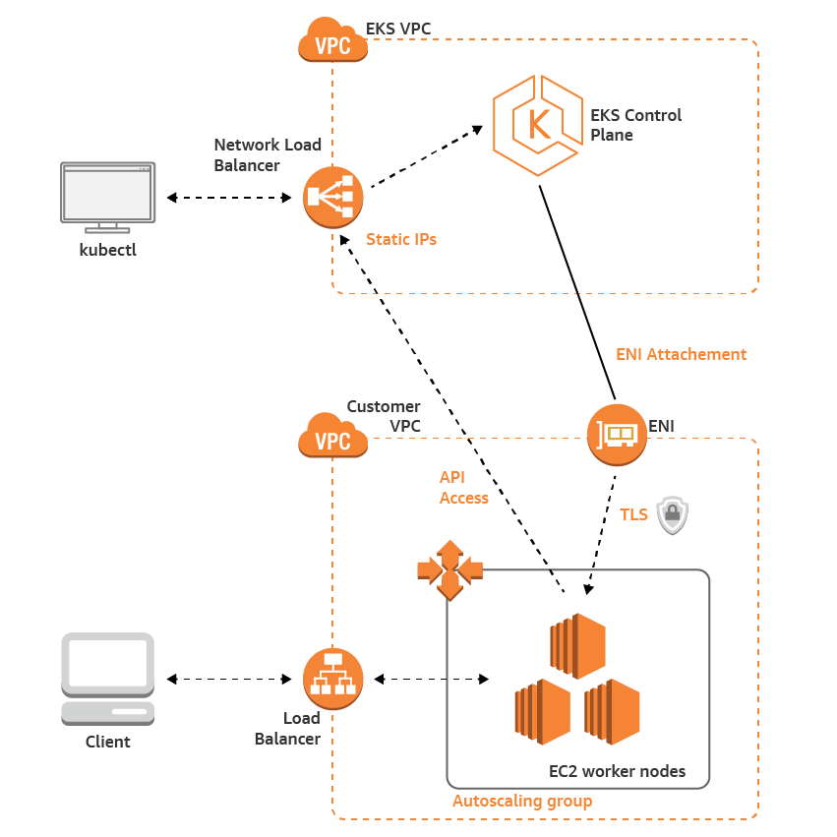
EKS
Amazon EKS is a fully managed service that makes it easy to deploy, manage, and scale containerized applications using Kubernetes on AWS.
Amazon EKS runs the Kubernetes control plane for you across multiple AWS availability zones to eliminate a single point of failure.

Slide 11
Demo on Lambda Function from Browser script

